Slide 1
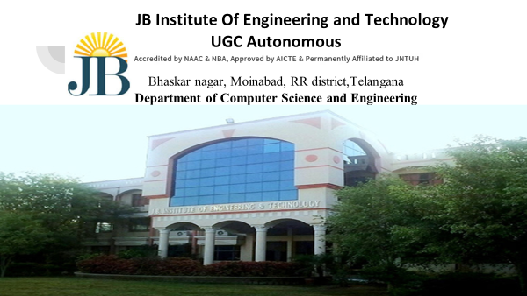

Slide 2

Suspicious Human activity detection
Group Members:
21675A0506 : MA Shaik Shoyeb
20671A0501 : Ahammad Ali
20671A0542 : Thalaboina Rakesh
20671A0528 : Azmath Ali
20671A0513 : G.Vamsi
Under the Guidance of:- G. Sreenivasulu

Slide 3
ABSTRACT
With the increasing prevalence of closed-circuit television (CCTV) systems in public and private spaces, the need for effective surveillance and security measures has become paramount. This study presents an integrated approach for the detection of suspicious activities using CCTV footages, aiming to enhance public safety and security. This project leverages advancements in computer vision and machine learning techniques to automatically analyze video streams and identify anomalous behavior. The primary focus is on domestic settings where privacy concerns and the need for accurate detection are particularly crucial. The research involves the development of a robust model capable of recognizing a diverse range of suspicious activities without compromising individual privacy. The methodology includes the collection of a comprehensive dataset, encompassing various normal and suspicious activities in domestic environments. Frame-level and temporal features are extracted using convolutional neural networks (CNNs) for spatial information and recurrent neural networks (RNNs) for temporal dependencies. The model is trained and fine-tuned using advanced deep learning techniques to optimize performance. The proposed system represents a significant step towards the development of intelligent surveillance solutions that balance the imperative of public safety with the importance of individual privacy.

Slide 4
INTRODUCTION
In an era marked by escalating security concerns and technological advancements, our project, "Suspicious Activity Detection through Deep Learning Integration with CCTV Surveillance," represents a pioneering effort to redefine the capabilities of surveillance systems. The primary objective of this project is to develop a sophisticated framework that employs deep learning techniques to autonomously detect and categorize suspicious activities within CCTV surveillance footage.
The increasing ubiquity of surveillance cameras in public and private spaces provides an opportunity to enhance security measures. Traditional surveillance systems often struggle to effectively differentiate between normal and potentially threatening activities. Our motivation is to address this limitation by harnessing the capabilities of deep learning, a subset of artificial intelligence that excels in learning intricate patterns from complex data.

Slide 5
OBJECTIVES
Enhanced Detection Accuracy: Utilizing state-of-the-art deep learning architectures, our system aims to achieve superior accuracy in distinguishing between normal and anomalous behaviors within surveillance footage.
Temporal and Spatial Analysis: The project integrates temporal modeling techniques such as recurrent neural networks (RNNs) with spatial feature extraction using convolutional neural networks (CNNs). This approach allows for a holistic analysis of both the temporal and spatial dimensions of video sequences.
Real-time Processing: Implementing efficient algorithms for real-time processing, our framework ensures timely identification of suspicious activities, facilitating prompt responses to potential security threats.

Slide 6
EXISTING SYSTEMS
Before the implementation of advanced surveillance systems, various traditional approaches and human-centric methods contribute to maintaining security and identifying potential threats. Here's a brief overview:
Manual Monitoring: Human security personnel manually monitor CCTV feeds in real-time.
Incident Reporting: Community members or on-site security personnel report suspicious activities.
Resource Requirements: Effective manual monitoring requires a significant allocation of human resources, leading to high operational costs.
Limitations of Existing Approaches:
Subjectivity: Human monitoring is subjective and may be influenced by biases or fatigue.
Scalability: Human-centric approaches struggle to scale efficiently in large or complex environments.
Delay in Response: Reactive measures might lead to delays in responding to potential threats.
Limited Automation: Rule-based systems lack adaptability and may produce false alarms or miss nuanced patterns.

Slide 7
PROPOSED SYSTEM
The proposed system aims to overcome their limitations by introducing automation, real-time analysis, and the ability to learn complex patterns. The advanced system seeks to:
Improve Accuracy: By leveraging deep learning, the system aims to enhance accuracy in identifying both known and novel suspicious activities.
Enable Real-time Detection: Unlike manual monitoring, the proposed system processes video feeds in real-time, allowing for immediate identification and response.
Scale Efficiency: Through automated analysis, the system aims to scale efficiently across various environments, reducing the need for extensive human resources.
Address Privacy Concerns: Privacy-preserving mechanisms in the proposed system aim to strike a balance between security and privacy.
Facilitate Proactive Measures: By detecting suspicious activities promptly, the system aims to enable proactive measures, preventing incidents before they escalate.

Slide 8
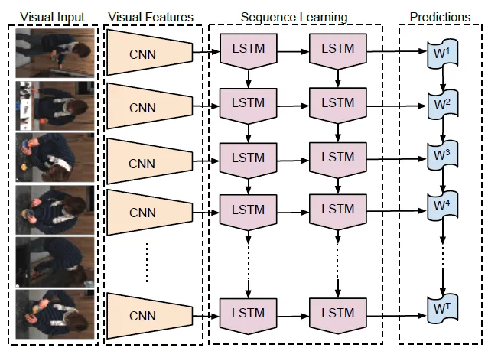
ARCHITECHTURE OF MODEL

Slide 9
THANK YOU

